Slide 1

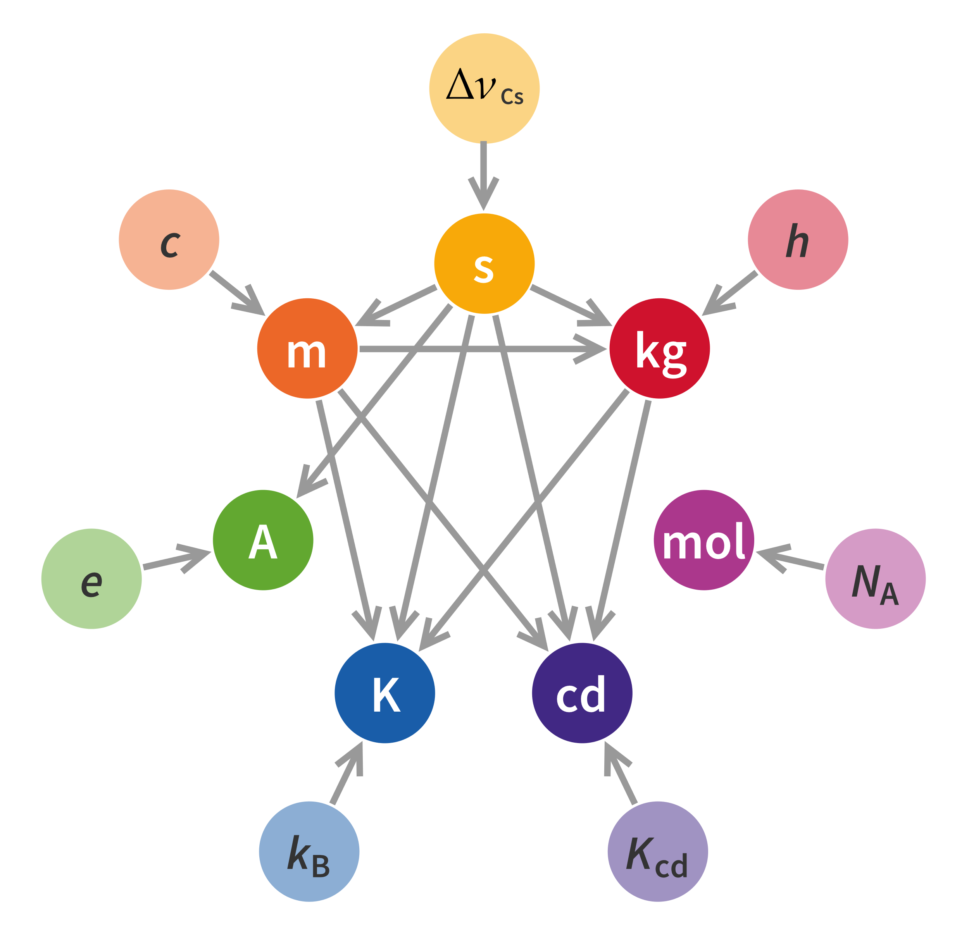
International System of Quantities library in VDM
The 21st Overture Workshop
10th March 2023
Leo Freitas
School of Computing, Newcastle University

Slide 2
Introduction
Most used system of measurements
Elegant, minimal and coherent
Seven base units, new units are coherent derivations
Formal representation of these units is important
Reduced error-prone and tedious calculations
History: used for personalised medicine application conversions

Slide 3

Base Units
Quantity | Symbol | Dimension | SI Name | SI Symbol
Length | l | L | metre | M
Mass | m | M | kilogram | kg
Time | t | T | second | s
Electric Current | I | I | ampere | A
Thermodynamic Temperature | T | Ɵ | kelvin | K
Amount of Substance | n | N | mole | mol
Luminous Intensity | I_{v} | J | candela | cd

Slide 4
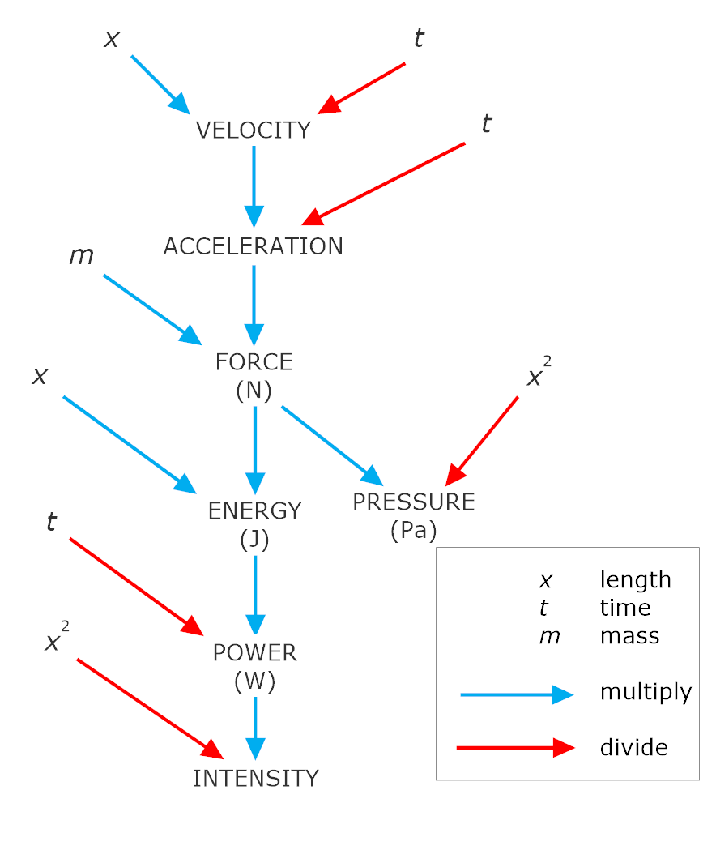
Derived Units
ISQ Base Unit Relationships
ISQ Unit Combination and Conversion

Slide 5
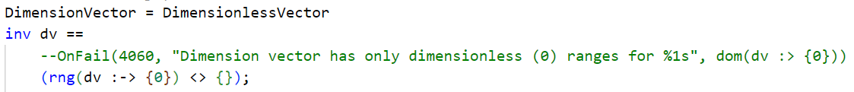
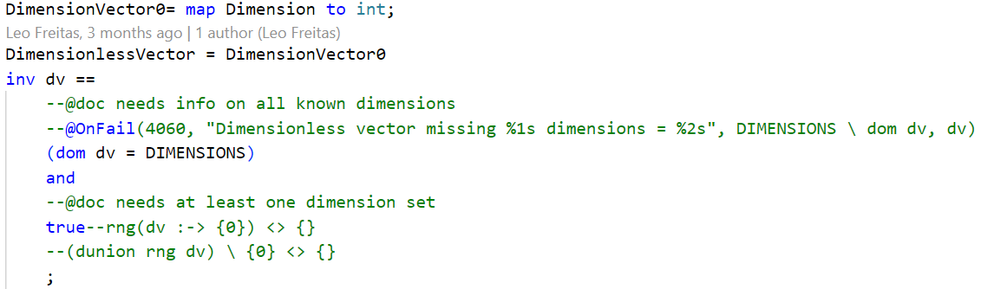
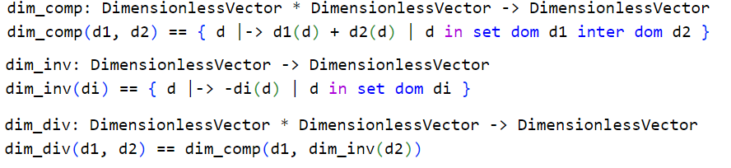
Dimension Vector
Map to define a dimension(or unit) in terms of the relations between the base units (1)
Enables representation of base and derived units
Most common dimensions (7 base and 15 derived) are predefined
Dimensionless vectors defined pure quantities (e.g. radians) (2)
Operators exist to combine the derived dimensions (3)
1
2
3

Slide 6
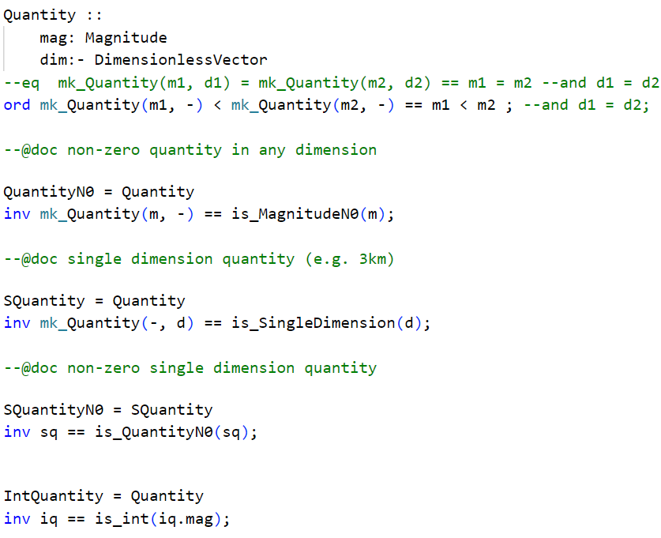
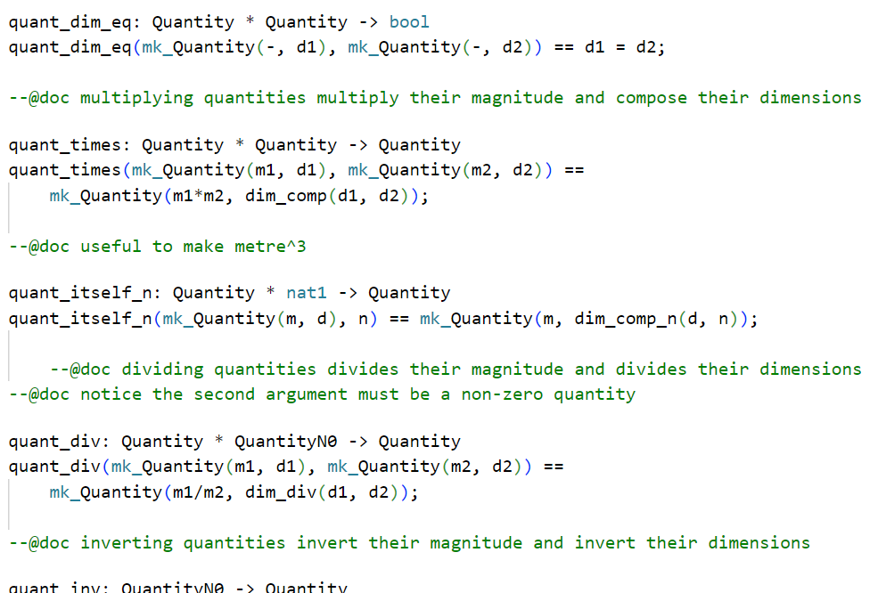
Quantities
Represents magnitude of a dimension
Used for conversion computation between different measurement systems
Comparison and ordering within same dimension
By default quantities are real
Different varieties defined (1)
Integer magnitudes
Single dimension
Several operators for quantities exist (2)
Multiplication
Subtraction
Replication
etc
1
2

Slide 7
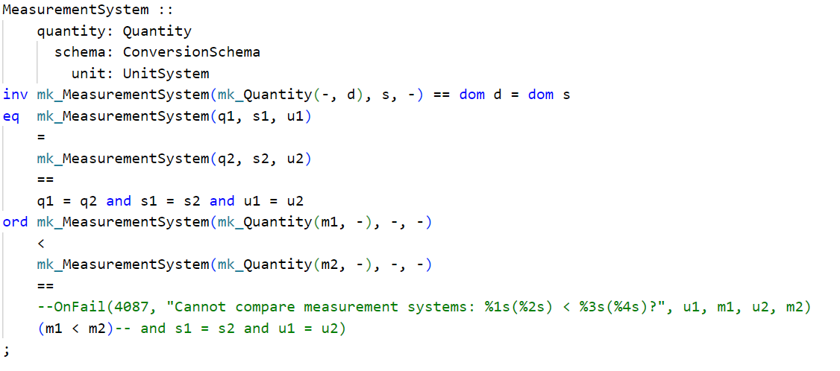
Measurement Systems
Named quantities with a dimension and conversion schema (1)
Measurement systems are defined for all dimension (base or derived)
Conversion schemas define how conversion from base factor can be done (2)
Standard conversion schema for ISQ is an identity map
1
2

Slide 8
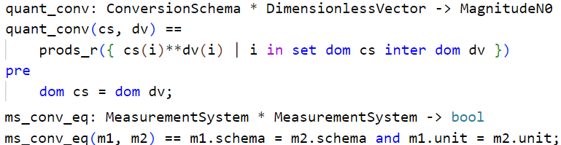
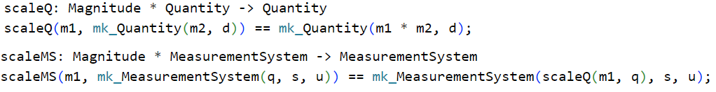
Scaling and Conversion
Scaling is the product of magnitudes
Scaling two quantities ignores dimension vectors unlike scaling measurement systems
Scaling takes dimension vector of leading entity
Converts a magnitude using the given conversion schema
Quantity convert uses set product of integer exponents for corresponding schemas
Be aware of potential real precision issues

Slide 9
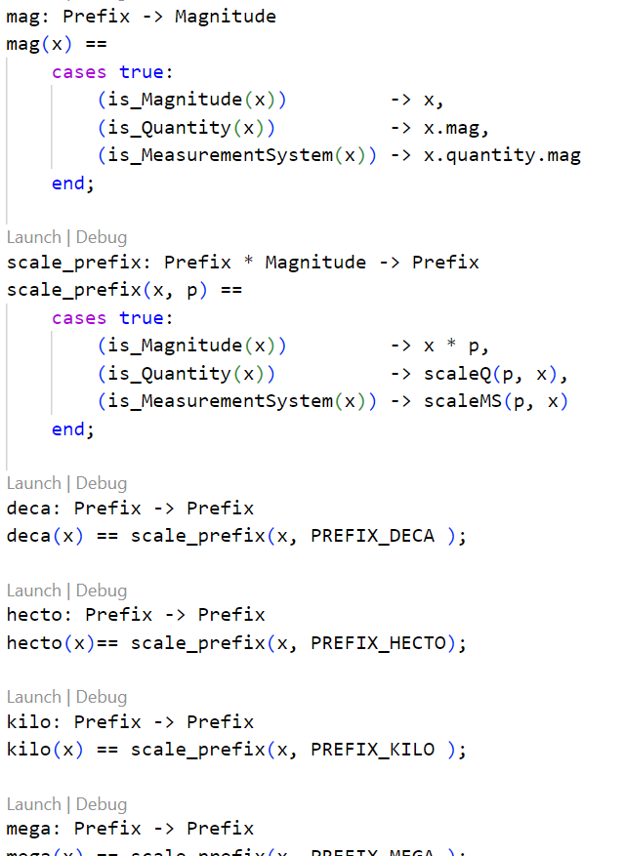
Common Prefixes
Prefix allow for ease of use
Prefixes work on
Measurement systems
Quantity
Magnitude
Uses VDM Union types to reduce duplication of code

Slide 10
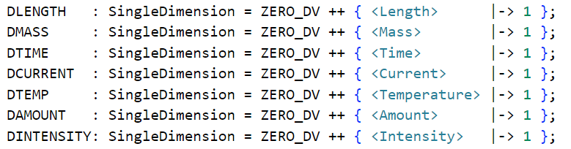
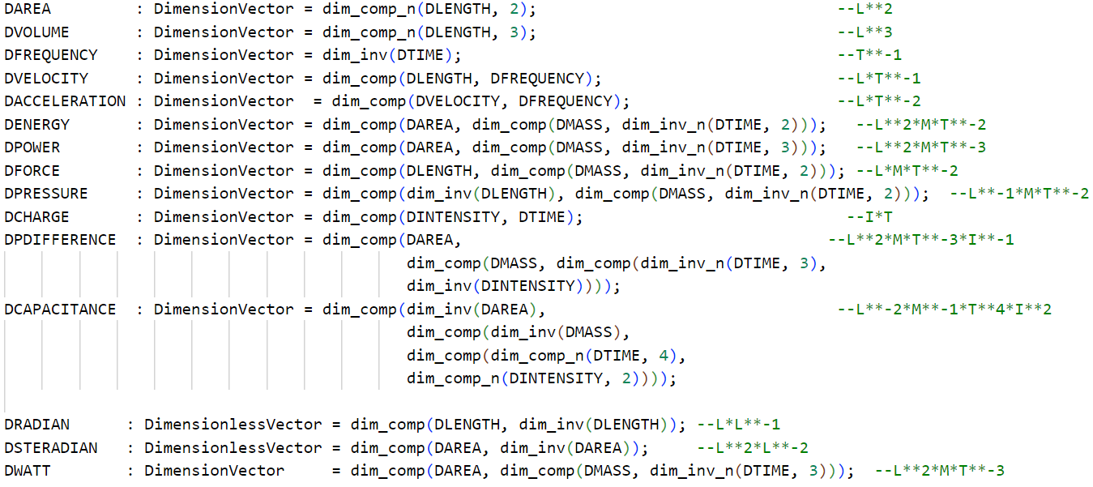
Example: Dimensions
Basic Dimensions
Pure Quantities
Derived Dimensions

Slide 11
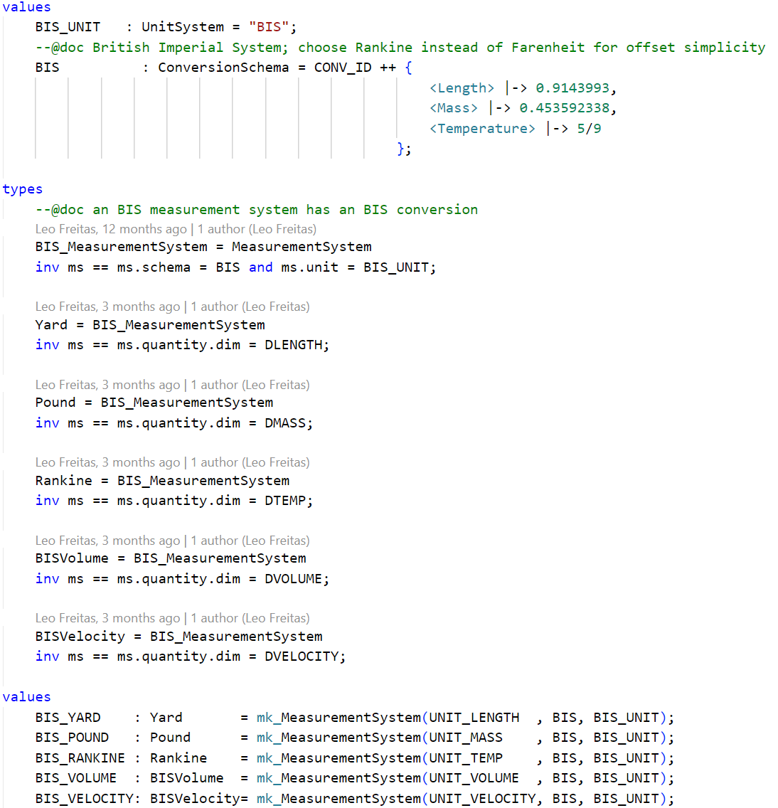
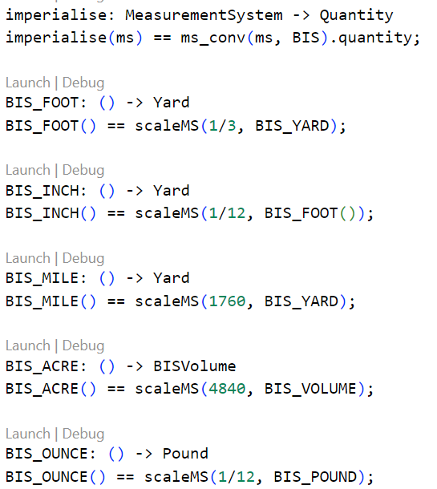
Example: British Imperial System (BIS)
Conversion Schema
General Conversion Function
Measurement System Types
Scaling Functions
Measurement System

Slide 12
Additional Notes
Define alternate non-decimal system like Imperial or standard date/time
Common constants are also defined in this library
ISQ library works with VDMJ high precision
ISQ provides some approximation function that should be taken into account for high-precision calculations

Slide 13
Future Works
Exploring use into industrial applications
Expanding list of units defined to include
All units in the SI tables
Physical quantities list

Slide 14
Thanks for Listening

